Slide 1
Tailoring Credit Cards for Tomorrow: Customer Insights & Strategic Directions for Mitron Bank
Submitted By
Sulaiman Ahmed
Live Dashboard: Mitron Bank Customer Insights

Slide 2
Table of contents
01
02
03
Introduction
Data Info
Cluster Analysis
04
05
Dashboard
Recommendation
Problem Statement & Summary
All about Data
Implementing ML Algorithm
Interpretation of Report Pages
Suggestions or Inquiries

Slide 3
01
Introduction
Problem Statement & Summary

Slide 4
1. Introduction – Problem Statement
Mitron Bank's Goal is to introduce a new line of credit cards to expand market reach.

Slide 5
1. Introduction – Summary
Project Overview
AtliQ's Proposal
Offered to implement the project using data-driven insights.
Mr. Bashnir Rover's Condition
Sample dataset of 4000 customers across five cities.
Pilot success critical for full project approval and strategy development.
Approve only after a successful pilot project.
Pilot Project Data
Focus
Analyze online spending patterns to inform credit card features.
Outcome

Slide 6
1. Introduction – End Goal
Customer Demographics & Income/Expenditure Insights
Providing data driven decisions to increase credit card usage
End Goal

Slide 7
1. Introduction – Project Initialization
Demographics
Depiction of Diverse Customer Base
Segment-Specific Insights
Income & Expense Analytics
Illustration of Spending Habits
Mitron Bank Customer Insights Dashboard
Insights on Payment Preference

Slide 8
02
Data Info
All About Data

Slide 9
2. Data Description
dim_customers
gender
fact_spends
customer_id
Data Tables
spends
age_group
marital_status
City
month
category
payment_type
Occupation
average_income
customer_id

Slide 10
03
Cluster Analysis
Implementing ML Algorithm

Slide 11
3. Cluster Analysis
Overview
K-Means clustering is a popular unsupervised machine learning algorithm used to divide data into a predefined number of clusters, where each data point belongs to the cluster with the nearest mean.
K-Means is widely used for market segmentation, pattern recognition. In this project I used this ML algorithm to categorize income and expense.
Unsupervised machine learning uncovers hidden patterns or intrinsic structures in data without using labeled responses or outcomes.

Slide 12
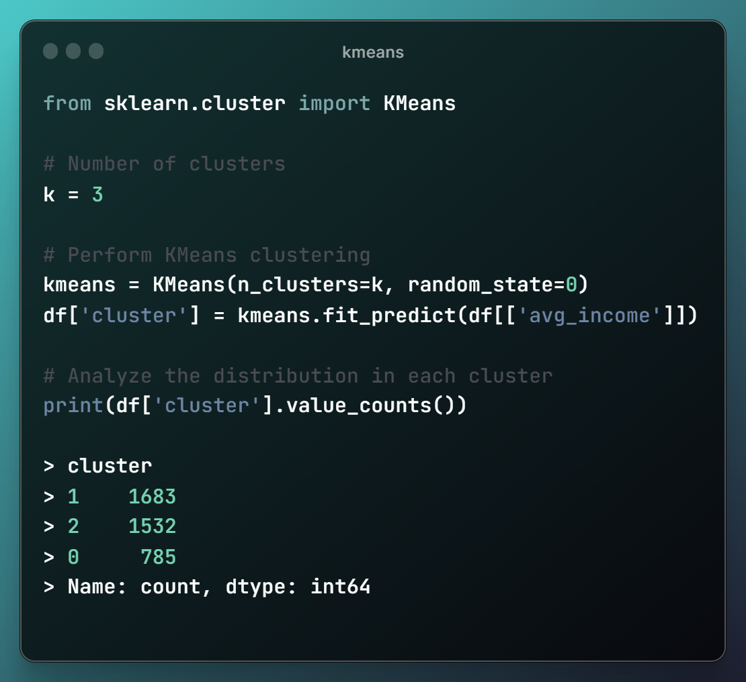
3. Cluster Analysis
The KMeans algorithm was applied to segment the data into three clusters (k=3).
Clustering was based on the 'avg_income' feature of the dataset.
The resulting clusters had sizes of 1683 for Cluster 1, 1532 for Cluster 2, and 785 for Cluster 0.

Slide 13
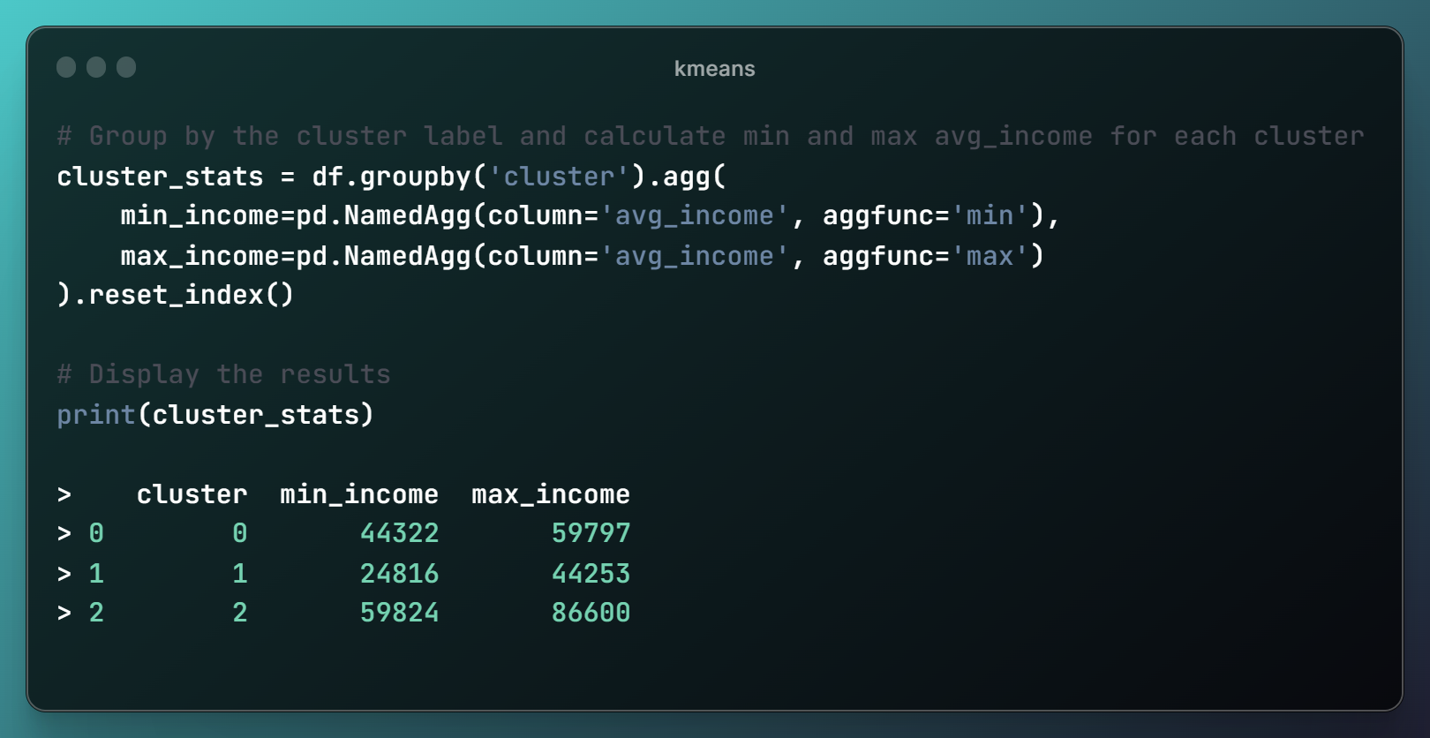
3. Cluster Analysis
The KMeans algorithm identified three customer clusters with distinct income ranges.
Lowest income range with a minimum of $24,816 and a maximum of $44,253.
Moderate income range with a minimum of $44,322 and a maximum of $59,797.
Highest income range with a minimum of $59,824 and a maximum of $86,600.

Slide 14
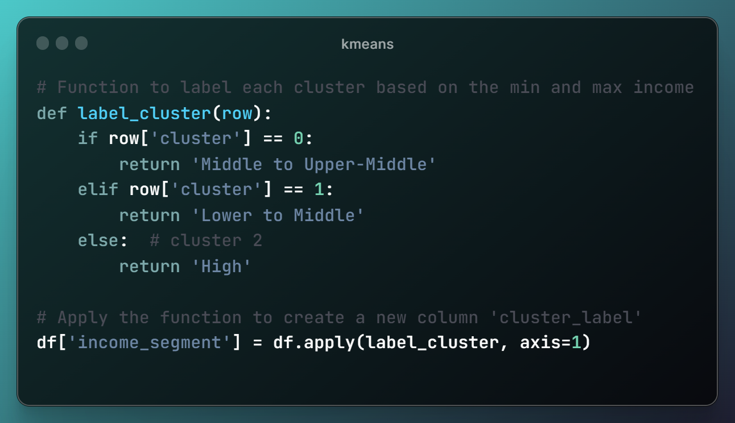
3. Cluster Analysis
Clusters 0, 1, and 2 are labeled as 'Middle to Upper-Middle', 'Lower to Middle', and 'High' income segments, respectively.
A function is applied to the dataframe to create a new column with these labels.

Slide 15
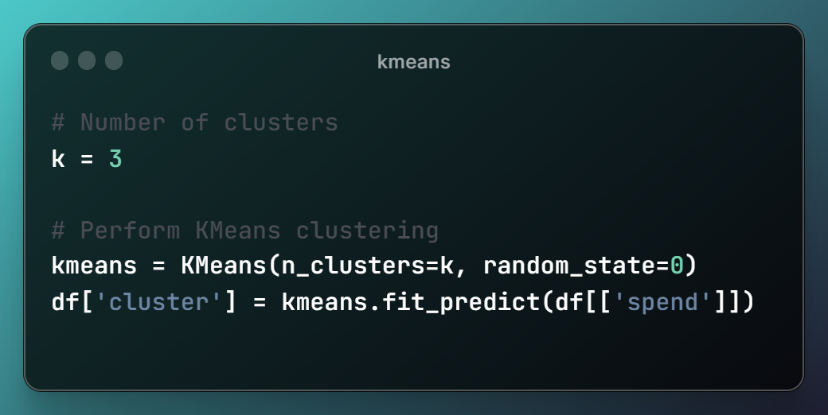
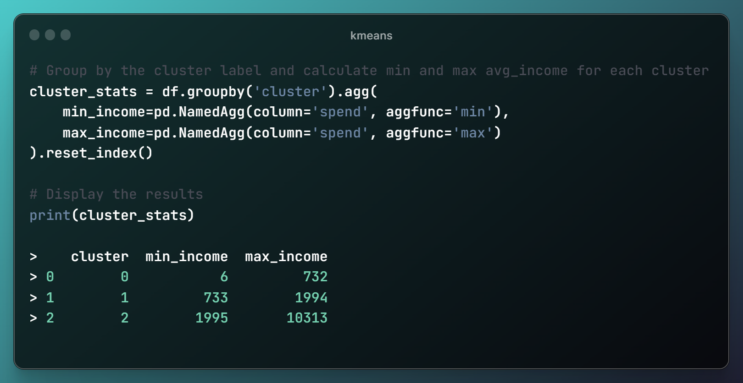
3. Cluster Analysis

Slide 16
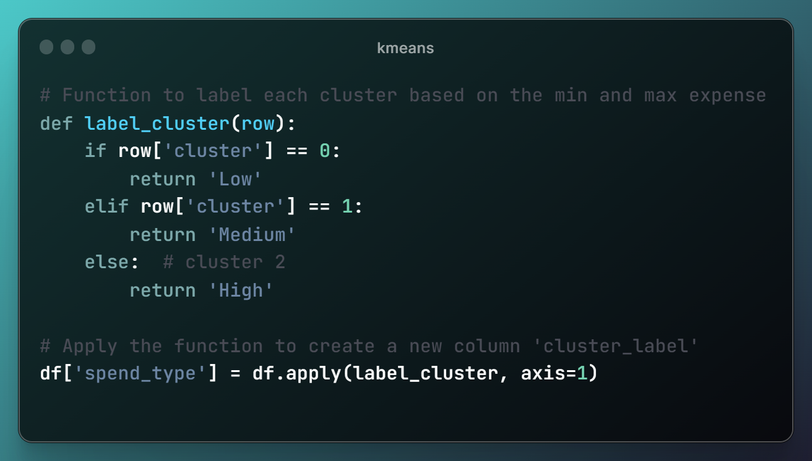
3. Cluster Analysis
Clusters 0, 1, and 2 are labeled as ‘Low', ‘Medium', and 'High’ Spending types, respectively.

Slide 17
04
Dashboard
Interpretation of Report Pages

Slide 18
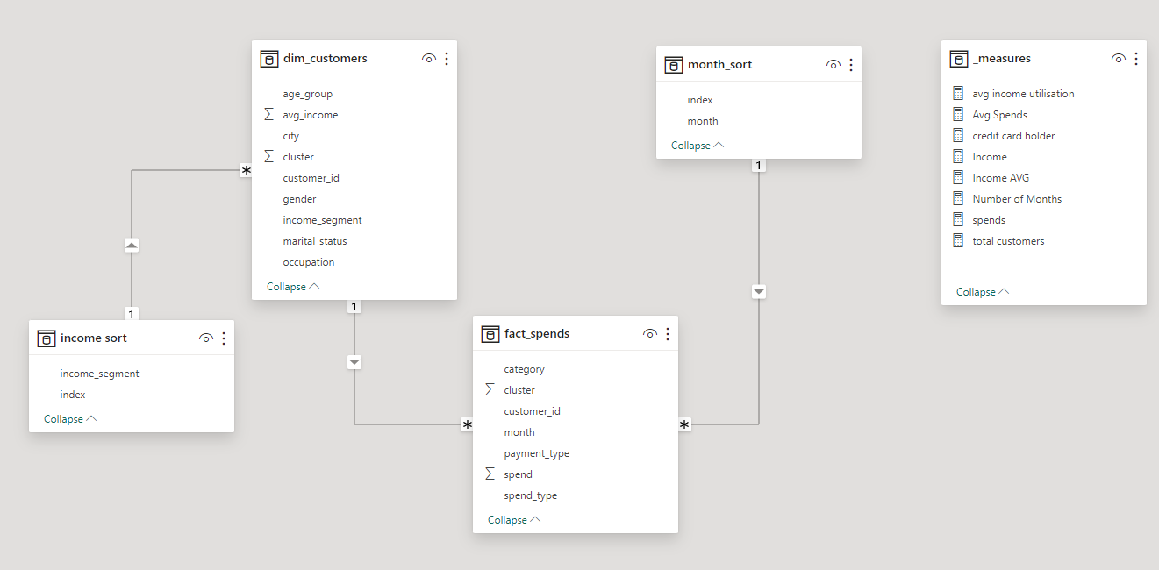
4. Dashboard– Data Model
The data model consists of:
1. dim_customers: Dimension table with customer demographic and segmentation data.
2. fact_spends: Fact table tracking customer spending details.
3. income_sort & month_sort: Auxiliary tables is for indexing and sorting.
4. _measures: Calculations and aggregate measures for analysis.
5. Star Schema: The layout suggests a star schema, optimal for querying and reporting.

Slide 19
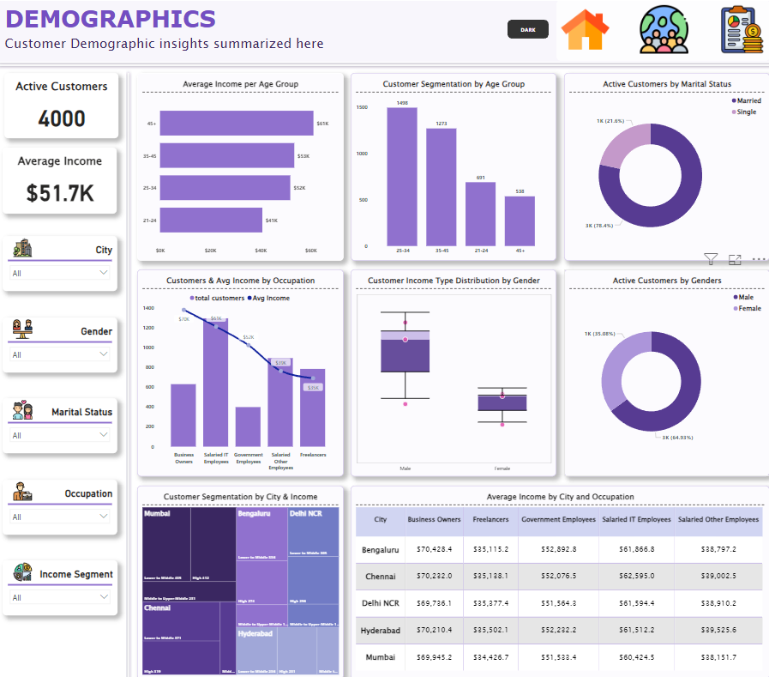
4. Dashboard– Customer Demographics

Slide 20
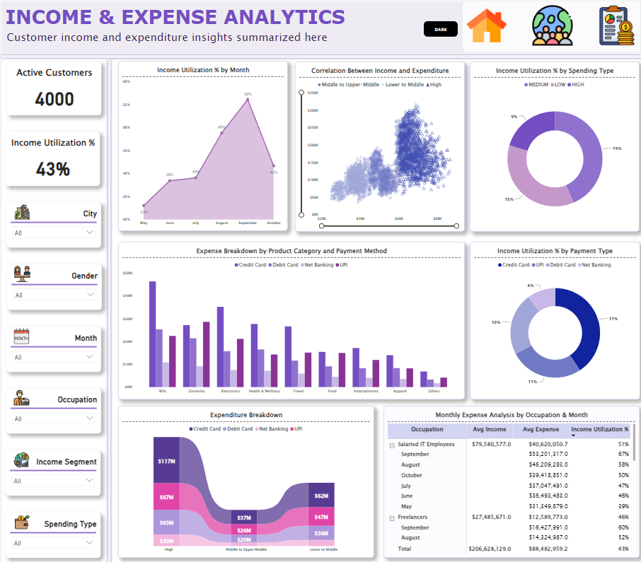
4. Dashboard – Income & Expense Analytics

Slide 21
4. Dashboard– Customer Demographics
Potential Recommendations
Focus on credit card rewards for online shopping and digital services to appeal to the largest customer segment aged 25-34.
Introduce tiered credit card benefits matching the varying income levels across different age groups and occupations.
Develop family-oriented rewards such as discounts on healthcare and education, catering to the predominantly married customer base.
Create occupation-specific cards offering rewards for business expenses for entrepreneurs and practical benefits for salaried employees.
Capitalize on the high usage of credit and digital payments by enhancing mobile app features and contactless card options.

Slide 22
4. Dashboard– Income & Expense Analytics
Potential Recommendations
Launch targeted credit card promotions during months with the highest income utilization to drive sign-ups and spending.
Offer tiered credit card benefits aligned with customers' income segments—low, mid, and high—to cater to their specific financial capabilities.
Introduce incentives for digital payment methods, reflecting the high usage of credit cards and UPI, to increase transaction volume.
Develop rewards programs for high-spend categories like bills, groceries and health, enhancing the card's appeal and usage frequency.
Design cards with perks tailored to occupation-related spending, such as travel benefits for IT professionals who show higher earning and spending trends.

Slide 23
5. Recommendations
If you have any recommendations or inquiries regarding the project, please don't hesitate to reach out. Your input is valuable to me and can help me further improve.
Contact Information
Email: sulaimanahmed013@gmail.com
LinkedIn: linkedin.com/in/sulaimanahmed/
Portfolio Website: https://sulaimanahmed013.wixsite.com/my-site
Live Dashboard: Mitron Bank Customer Insights

